Slide 1
Orthogonal Projection
Hung-yi Lee

Slide 2
Reference
Textbook: Chapter 7.3, 7.4

Slide 3
Orthogonal Projection
What is Orthogonal Complement
What is Orthogonal Projection
How to do Orthogonal Projection
Application of Orthogonal Projection

Slide 4

Orthogonal Complement
The orthogonal complement of a nonempty vector set S is denoted as S⊥ (S perp).
S⊥ is the set of vectors that are orthogonal to every vector in S
$$S^{\text{⊥}}=\left\{v:v⋅u=0,∀u∈S\right\}$$
W⊥
S = R^{n} ⇒ S⊥ = {0}
W
S = {0} ⇒ S⊥ = R^{n}
Notes:
v和所有的u都正交

Slide 5
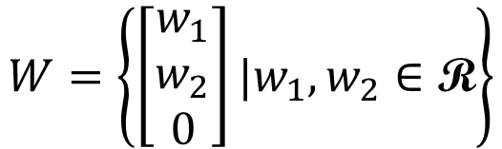

Orthogonal Complement
The orthogonal complement of a nonempty vector set S is denoted as S⊥ (S perp).
S⊥ is the set of vectors that are orthogonal to every vector in S
$$S^{\text{⊥}}=\left\{v:v⋅u=0,∀u∈S\right\}$$
$$W=\left\{\left[\begin{aligned}w_{1} \\ w_{2} \\ 0\end{aligned}\right]|w_{1},w_{2}∈\text{R}\right\}$$
V ⊆ W⊥:
for all v ∈ V and w ∈ W, v • w = 0
W⊥ ⊆ V:
$$V=\left\{\left[\begin{aligned}0 \\ 0 \\ v_{3}\end{aligned}\right]|v_{3}∈\text{R}\right\}$$
= W⊥?
since e₁, e₂ ∈ W, all z = [ z₁ z₂ z₃ ]^{T} ∈ W⊥ must have z₁ = z₂ = 0
Notes:
by z • e₁ = z • e₂ = 0

Slide 6




Properties of Orthogonal Complement
Is $S^{\text{⊥}}$ always a subspace?
For any nonempty vector set S, ${\left(Span S\right)}^{\text{⊥}}=S^{\text{⊥}}$
Let W be a subspace, and B be a basis of W.
$B^{\text{⊥}}=W^{\text{⊥}}$
What is ${S∩S}^{\text{⊥}}$?
Zero vector
Notes:
Use the three propertites

Slide 7

Properties of Orthogonal Complement
Example:
For W = Span{u₁, u₂}, where u₁ = [ 1 1 −1 4 ]^{T} and u₂ =[ 1 −1 1 2 ]^{T}
v ∈ W⊥ if and only if u₁ • v = u₂ • v = 0
i.e., v = [ x₁ x₂ x₃ x₄ ]^{T} satisfies
⇔
⇔
is a basis for W⊥.
W⊥
= Solutions of “Ax=0”
= Null A
Notes:
Proof You show that (a basis of W)∪(a basis of W⊥) = a basis of R^{n}.

Slide 8


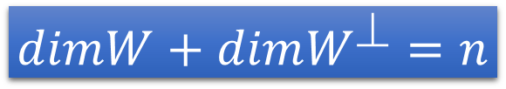
Properties of Orthogonal Complement
For any matrix A
$${\left(Row A\right)}^{\text{⊥}}=Null A$$
v ∈ (Row A)⊥ ⇔ For all w ∈ Span{rows of A}, w • v = 0
⇔ Av = 0.
${\left(Col A\right)}^{\text{⊥}}=Null A^{T}$
(Col A)⊥ = (Row A^{T}) ⊥ = Null A^{T} .
For any subspace W of R^{n}
$$dimW+dimW^{\text{⊥}}=n$$
rank
nullity

Slide 9
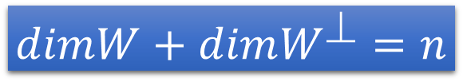
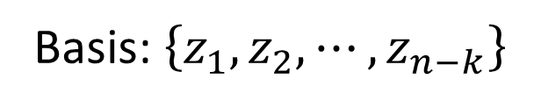
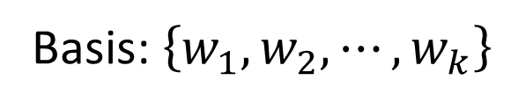


Unique
For any subspace W of R^{n}
$$dimW+dimW^{\text{⊥}}=n$$
Basis: $\left\{w_{1},w_{2},⋯,w_{k}\right\}$
Basis: $\left\{z_{1},z_{2},⋯,z_{n−k}\right\}$
Basis for R^{n}
For every vector u,
W⊥
u
u = w + z
(unique)
z
W
w
$$∈W$$
$$∈W^{\text{⊥}}$$
0
Notes:
对于任意两个basis，它们之内都是independent的，但是这两个basis之间不一定是independent。
但是如果这两个分别是W和W_perp，那么这两个basis之间一定是independent的。

Slide 10
Orthogonal Projection
What is Orthogonal Complement
What is Orthogonal Projection
How to do Orthogonal Projection
Application of Orthogonal Projection

Slide 11
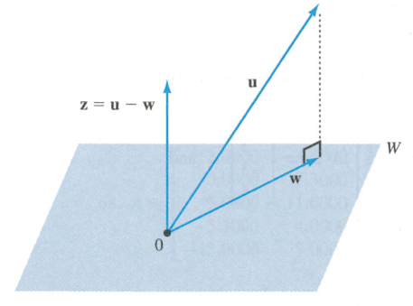




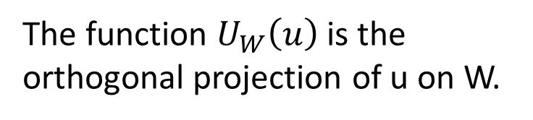
Orthogonal Projection
orthogonal projection
u = w + z
(unique)
$$∈W^{\text{⊥}}$$
$$z$$
$$∈W$$
$$∈W^{\text{⊥}}$$
Orthogonal Projection Operator:
The function $U_{W}\left(u\right)$ is the orthogonal projection of u on W.
Linear?

Slide 12
Orthogonal Projection
w in subspace W is “closest” to vector u.
$$∈W^{\text{⊥}}$$
$$z$$
“closest”
Always orthogonal
z is always orthogonal to all vectors in W.

Slide 13
Closest Vector Property
Among all vectors in subspace W, the vector closest to u is the orthogonal projection of u on W
u
∀ w, w′, w − w′ ∈ W.
⇒ (u − w) • (w − w′) = 0.
⇒ ||u − w′||²
= ||(u − w) + (w − w′)||²
= ||u − w||² + ||w − w′||²
> ||u − w||²
w
w’
0
w = U_{W}(u)
W
The distance from a vector u to a subspace W is the distance between u and the orthogonal projection of u on W

Slide 14


Orthogonal Projection Matrix
Orthogonal projection operator is linear.
It has standard matrix.
Orthogonal Projection Matrix P_{w}
u
z = u - w
w = U_{W}(u)
$$=P_{W}u$$
0
v = U_{W}(v)
$$=P_{W}v$$
W
Notes:
Proposition: U_{W} is linear.
Proof If U_{W}(u₁) = w₁ and U_{W}(u₂) = w₂, then ∃ unique z₁, z₂ ∈W⊥
such that u₁ = w₁+z₁ and u₂ = w₂+z₂ ⇒ u₁+u₂ = w₁+w₂ + z₁+z₂
⇒ U_{W}(u₁+u₂) = w₁+w₂ since w₁+w₂ ∈W and z₁+z₂ ∈W⊥
Similarly U_{W}(cu) = cw ∀c, u

Slide 15
Orthogonal Projection
What is Orthogonal Projection
How to do Orthogonal Projection
Application of Orthogonal Projection
What is Orthogonal Complement

Slide 16
Orthogonal Projection on a line
Orthogonal projection of a vector on a line
$$z∙u=0$$
v
v: any vector
u: any nonzero vector on L
w: orthogonal projection of
v onto L , w = cu
z: v − w
z
L
z
u
w
$$\left(v−w\right)∙u$$
$$=\left(v−cu\right)∙u$$
$$=v∙u−cu∙u$$
$$=v∙u−c{\left\|u\right\|}^{2}$$
$$c=\frac{v∙u}{{\left\|u\right\|}^{2}}$$
$$w=cu=\frac{v∙u}{{\left\|u\right\|}^{2}}u$$
=0
Distance from tip of v to L :
$$=\left\|v−\frac{v∙u}{{\left\|u\right\|}^{2}}u \right\|$$
$$\left\|z\right\|=\left\|v−w\right\|$$
Notes:
W in terms of u
Tip: 頂端；尖端

Slide 17



Orthogonal Projection
$$c=\frac{v∙u}{{\left\|u\right\|}^{2}}$$
$$w=cu=\frac{v∙u}{{\left\|u\right\|}^{2}}u$$
Example:
$$z∙u=0$$
v
z
L is y = (1/2)x
L
z
u
$$v=\left[\begin{aligned}4 \\ 1\end{aligned}\right]$$
$$u=\left[\begin{aligned}2 \\ 1\end{aligned}\right]$$
w
Notes:
$$w=\frac{v∙u}{{\left\|u\right\|}^{2}}u$$
$$=\frac{9}{5}\left[\begin{aligned}2 \\ 1\end{aligned}\right]$$
$$\left\|\left[\begin{aligned}4 \\ 1\end{aligned}\right]−\frac{9}{5}\left[\begin{aligned}2 \\ 1\end{aligned}\right]\right\|$$
$$=\frac{1}{5}\left\|\left[\begin{aligned}2 \\ −4\end{aligned}\right]\right\|$$
$$=\frac{2}{5}\sqrt{5}$$

Slide 18

Orthogonal Projection Matrix
Let C be an n x k matrix whose columns form a basis for a subspace W
$$P_{W}=C{\left(C^{T}C\right)}^{−1}C^{T}$$
n x n
Proof: Let u ∈ R^{n} and w = U_{W}(u).
Since W = Col C, w = Cv for some v ∈ R^{k}
and u − w ∈W⊥
⇒ 0 = C^{T}(u − w) = C^{T}u − C^{T}w = C^{T}u − C^{T}Cv.
⇒ C^{T}u = C^{T}Cv.
⇒ v = (C^{T}C)⁻¹C^{T}u and w = C(C^{T}C)⁻¹C^{T}u as C^{T}C is invertible.
Notes:
C^{T}C一定是invertible的

Slide 19

Orthogonal Projection Matrix
Let C be an n x k matrix whose columns form a basis for a subspace W
$$P_{W}=C{\left(C^{T}C\right)}^{−1}C^{T}$$
n x n
Let C be a matrix with linearly independent columns. Then $C^{T}C$ is invertible.
Proof: We want to prove that C^{T}C has independent columns.
Suppose C^{T}Cb = 0 for some b.
⇒ b^{T}C^{T}Cb = (Cb)^{T}Cb = (Cb) • (Cb) = ||Cb||² = 0.
⇒ Cb = 0 ⇒ b = 0 since C has L.I. columns.
Thus C^{T}C is invertible.

Slide 20




Orthogonal Projection Matrix
Example: Let W be the 2-dimensional subspace of R³ with equation x₁ − x₂ +2x₃ = 0.
$$P_{W}=C{\left(C^{T}C\right)}^{−1}C^{T}$$
W has a basis
$$C=$$
$$P_{W}\left[\begin{aligned}1 \\ 3 \\ 4\end{aligned}\right]=\left[\begin{aligned}0 \\ 4 \\ 2\end{aligned}\right]$$
$$P_{W}=$$

Slide 21
Orthogonal Projection
What is Orthogonal Projection
How to do Orthogonal Projection
Application of Orthogonal Projection
What is Orthogonal Complement

Slide 22
Solution of Inconsistent System of Linear Equations
Suppose Ax = b is an inconsistent system of linear equations.
b is not in the column space of A
Find vector z minimizing ||Az − b||
b
||Ax − b||
||Az − b||
Ax
0
Az = P_{W}b
W = Col A

Slide 23
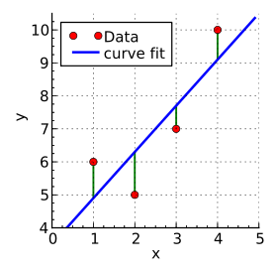
Least Square Approximation
data pairs:
x₁ → y₁
x₂ → y₂

x_{i} → y_{i}

predict
e.g.
(今天股票,明天股票)
(今天PM2.5,明天PM2.5)
Find the “least-square line” y = a₀ + a₁x to best fit the data
Regression
Notes:
Regression回歸

Slide 24
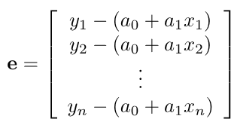





Least Square Approximation
$$y=a_{0}+a_{1}x$$
Error Vector:
$$\left(x_{i},a_{0}+a_{1}x_{i}\right)$$
$$y_{i}−\left(a_{0}+a_{1}x_{i}\right)$$
$$\left(x_{i},y_{i}\right)$$
Find a₀ and a₁ minimizing E

Slide 25

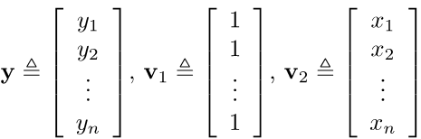

Least Square Approximation
Error Vector:
Find a₀ and a₁ minimizing E
E = ||y − (a₀v₁ + a₁v₂)||² = ||y − Ca||²

Slide 26
Least Square Approximation
Find a minimizing
E = ||y − Ca||²
B = {v₁, v₂}
(L.I.)
Ca is the orthogonal projection of y on W = Span B .
find a such that Ca = P_{W}y
Notes:
C是数据，a是我们要找的系数，Ca是我们预测的一条一维直线。
我们要找到一个Ca，离y最近。
也就是把y project到Ca上。
套公式把a解出来。
这里我们要找到的是a，系数，而不是Ca，投影后的值，所以两边都少一个C。

Slide 27
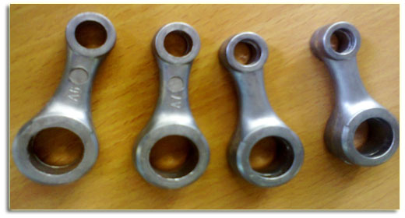
Example 1
⇒ y = 0.056 + 0.745x.
Prediction:
if the rough weight is 2.65,
the finished weight is
0.056 +0.745(2.65) = 2.030.
(estimation)
Notes:
connecting rod

Slide 28
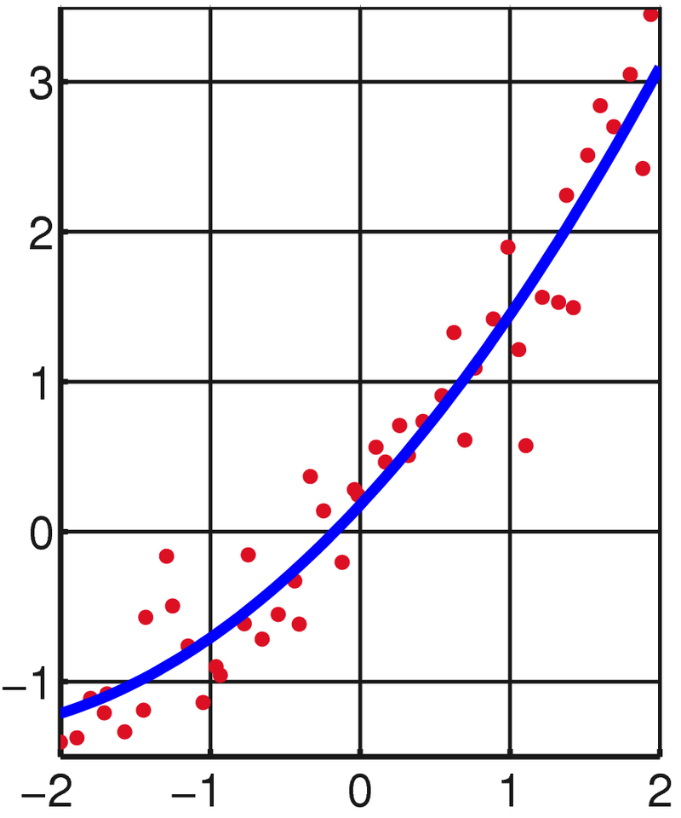

Least Square Approximation
Best quadratic fit: using y = a₀ + a₁x + a₂x² to fit the data points (x₁, y₁), (x₂, y₂), 😐, (x_{n}, y_{n})
$$e=\left[\begin{aligned}y_{1}−\left(a_{0}+a_{1}x_{1}+a_{2}x_{1}^{2}\right) \\ y_{2}−\left(a_{0}+a_{1}x_{2}+a_{2}x_{2}^{2}\right) \\ ⋮ \\ y_{n}−\left(a_{0}+a_{1}x_{n}+a_{2}x_{n}^{2}\right)\end{aligned}\right]$$
y = a₀ + a₁x + a₂x²
Find a₀, a₁ and a₂ minimizing E

Slide 29
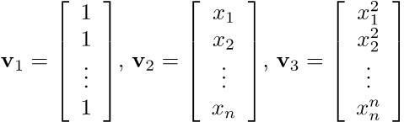


Least Square Approximation
Best quadratic fit: using y = a₀ + a₁x + a₂x² to fit the data points (x₁, y₁), (x₂, y₂), 😐, (x_{n}, y_{n})
$$e=\left[\begin{aligned}y_{1}−\left(a_{0}+a_{1}x_{1}+a_{2}x_{1}^{2}\right) \\ y_{2}−\left(a_{0}+a_{1}x_{2}+a_{2}x_{2}^{2}\right) \\ ⋮ \\ y_{n}−\left(a_{0}+a_{1}x_{n}+a_{2}x_{n}^{2}\right)\end{aligned}\right]$$
Find a₀, a₁ and a₂ minimizing E

Slide 30
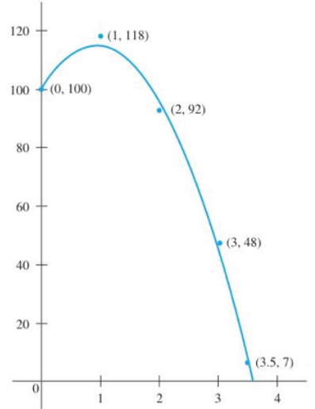


y = a₀ + a₁x + a₂x²
$$y=101.00+29.77x−16.11x^{2}$$
Best fitting polynomial of any desired maximum degree may be
found with the same method.

Slide 31
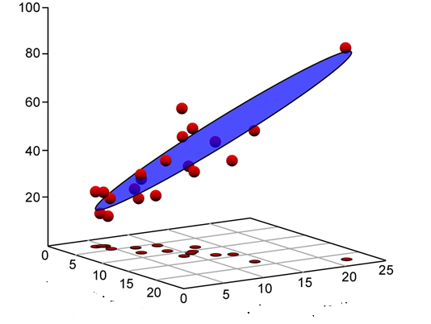




Multivariable Least Square Approximation
$$y_{A}$$
$$y_{A}=a_{0}+a_{1}x_{A}+a_{2}x_{B}$$
$$x_{A}$$
$$x_{B}$$
http://www.palass.org/publications/newsletter/palaeomath-101/palaeomath-part-4-regression-iv

